Slide 1




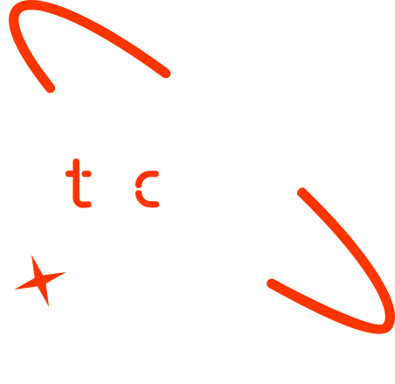

Hybrid ARIMA-LSTM Oil Price Forecasting
Graduate Name: Ermias Brhane Berhe
Date : 06/15/2025

Slide 2
Remove this page before uploading the presentation to your presentation!
How to use this template
Download the file.
Change the name into "Name_Surname_Groupnumber_Final_Presentation"​.
Do not move the text boxes, keep your text and visuals inside the boxes​.
Do not change the colors and font type​.
If you need to change the font size make it consistent and don't use different sizes in one page (biggest 28, smallest 20). Titles always should be 33,5.
You can duplicate a page if you need more than one pages​.
Add high quality pictures and their sources. Keep it inside the boxes.

Slide 3

Outline
Concept note and implementation plan
Background
Objectives
SDG Relation
Data
Data Collection
Exploratory Data Analysis et Feature Engineering
Model
Model Selection and Training
Model Evaluation and Hyperparameter Tuning
Model Refinement and Testing
Results
Evaluation Results
Deployment
Future Work

Slide 4
Concept note and Implementation Plan
Notes:
FTs like precision agriculture, remote sensing & AI-powered forming equipment can help increase agricultural productivity in LDCs. This can improve fiid security & contribute to the achievement of SDG 2 (Zero Hunger).

Slide 5
Background
The crude oil market has become highly unpredictable. This volatility is driven by a combination of global economic trends, geopolitical tensions, abrupt shifts in supply and demand, and changes in investor sentiment. These factors interact in complex, nonlinear ways that traditional forecasting methods struggle to capture.
Classical models like ARIMA and GARCH are effective at modeling linear relationships in time series data. However, they often fail to account for nonlinear patterns and structural breaks. Conversely, many machine learning models lack robustness in handling temporal dependencies and long-term sequences common in oil price data.
As a result, this unpredictability has significant impacts across sectors:
Airlines face unstable fuel costs, affecting route planning and ticket pricing
Investors are exposed to increased financial risk due to mispriced futures and assets.
Governments find it difficult to design timely and adaptive energy or fiscal policies.
Businesses struggle with cost forecasting and strategic planning under uncertainty.
To address this, we propose a hybrid ARIMA-LSTM model. It combines the strengths of both traditional statistical methods and deep learning: ARIMA captures the linear trends, while LSTM models the complex, nonlinear patterns in the residuals. Together, this approach aims to provide more accurate, real-time oil price forecasts—built for scalability and real-world deployment.
Notes:
FTs like precision agriculture, remote sensing & AI-powered forming equipment can help increase agricultural productivity in LDCs. This can improve fiid security & contribute to the achievement of SDG 2 (Zero Hunger).

Slide 6
Objectives
Primary Goals
Develop a hybrid ARIMA-LSTM model to enhance short-term crude oil price prediction.
Improve forecasting accuracy by integrating both linear trends (ARIMA) and nonlinear patterns (LSTM).
Build a prototype system capable of generating near real-time predictions.
Evaluate the system’s potential for scalability and practical deployment.
Technical Objectives
Implement and train an ARIMA model for capturing trend and seasonality.
Design and train a basic LSTM architecture to learn residual, nonlinear dynamics.
Combine outputs using a sequential hybrid approach.
Apply standard evaluation metrics (MAE, RMSE, R²) to assess performance.
Use time-based cross-validation and manual tuning to improve model generalization.
Build a simple FastAPI-based REST interface for model inference.
Notes:
FTs like precision agriculture, remote sensing & AI-powered forming equipment can help increase agricultural productivity in LDCs. This can improve fiid security & contribute to the achievement of SDG 2 (Zero Hunger).

Slide 7


SDG Relation
SDG 7 – Affordable and Clean Energy
Improved Forecasting: By enhancing oil price prediction accuracy, the model helps stabilize energy markets, contributing to affordable and reliable energy access.
Efficient Planning: Better predictions support governmental and industrial energy planning, especially in energy-import-dependent countries.
Risk Reduction: Reduces uncertainty for energy producers and consumers, indirectly supporting clean energy integration through better economic forecasting.
SDG 9 – Industry, Innovation, and Infrastructure
Innovation in Forecasting: Demonstrates a novel approach using hybrid statistical–deep learning models for time series forecasting in volatile domains.
Digital Infrastructure: Implements an end-to-end architecture (API ) that can be extended into scalable real-world applications.
Support for Energy-Dependent Industries: Reliable oil price forecasts help industries improve budgeting and reduce exposure to price shocks, improving economic resilience.
Notes:
FTs like precision agriculture, remote sensing & AI-powered forming equipment can help increase agricultural productivity in LDCs. This can improve fiid security & contribute to the achievement of SDG 2 (Zero Hunger).

Slide 8
Data
Notes:
FTs like precision agriculture, remote sensing & AI-powered forming equipment can help increase agricultural productivity in LDCs. This can improve fiid security & contribute to the achievement of SDG 2 (Zero Hunger).

Slide 9
Feature | Description | Type
Date | Date of trading session | Date
Open | Opening price of crude oil on the day (USD) | Float
High | Highest traded price on the day (USD) | Float
Low | Lowest traded price on the day (USD) | Float
Close/Last | Closing price of the oil on the day (USD) | Float
Volume | Trading volume (sum of buys and sells, unitless) | Integer
Data Collection
Source Information
Dataset Title: Crude Oil Price Prediction
Source Platform: Kaggle
Contributor: Saikumar Tamminana
Link: https://www.kaggle.com/datasets/saikumartamminana/crude-oil-price-prediction
License: Open for public use under Kaggle Terms of Service
Temporal Coverage
Start Date: January 1, 2012
End Date: December 31, 2022
Frequency: Daily (excluding weekends and holidays)
Duration: 11 years (~2,750 trading days)
Notes:
FTs like precision agriculture, remote sensing & AI-powered forming equipment can help increase agricultural productivity in LDCs. This can improve fiid security & contribute to the achievement of SDG 2 (Zero Hunger).

Slide 10
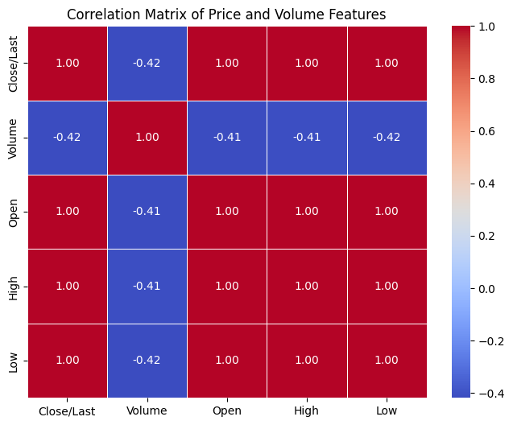
Exploratory Data Analysis and Feature Engineering
Total Feature
Close/Last: Daily closing price of crude oil (target variable).
Volume: Total trading volume for the day.
SMA_5: 5-day Simple Moving Average, captures short-term trend.
SMA_20: 20-day Simple Moving Average, reflects mid-term price direction.
RSI: 14-day Relative Strength Index, gauges momentum and overbought/oversold conditions.
MACD: Moving Average Convergence Divergence, detects trend reversals and momentum shifts.
EDA Findings:
Closing price and volume show high volatility and skewness. Data is clean and complete
from 2012 to 2022.
Feature Selection:
We dropped Open, High, and Low because they add little new information and caused redundancy issues during model evaluation.
Our model uses 13 features to capture both price dynamics and market behavior.
Notes:
FTs like precision agriculture, remote sensing & AI-powered forming equipment can help increase agricultural productivity in LDCs. This can improve fiid security & contribute to the achievement of SDG 2 (Zero Hunger).

Slide 11
Model
Notes:
FTs like precision agriculture, remote sensing & AI-powered forming equipment can help increase agricultural productivity in LDCs. This can improve fiid security & contribute to the achievement of SDG 2 (Zero Hunger).

Slide 12
Model Selection and Training
class HybridARIMALSTM:
def __init__(self, look_back=14, n_features=13):
self.look_back = look_back
self.n_features = n_features
self.arima_model = None
self.lstm_model = None
self.scaler = RobustScaler()
......................
Why ARIMA + LSTM?
Because crude oil prices exhibit both short-term linear trends and long-term nonlinear dependencies, a hybrid ARIMA + LSTM model captures both components.
ARIMA models the stationary linear structure, while LSTM learns residual nonlinearities and temporal patterns missed by ARIMA.ARIMA: For short-term linear components (trend + seasonality)
Captures autoregressive, integrated (trend-differencing), and moving average patterns
Used to model the stationary part of the signal
Residuals (errors) passed to LSTM for further modeling
LSTM: For residual nonlinear dynamics and long-range dependencies
Deep learning model for sequential forecasting
Input: Sliding time windows (sequence length = 14 days)
Architecture: Input layer → LSTM layer → Dense output
Input Layer: Shape (look_back, n_features)
Loss: MSE (Mean Squared Error)
Optimizer: Adam with learning rate 0.001
Batch Size: 32
Epochs: 50
Notes:
FTs like precision agriculture, remote sensing & AI-powered forming equipment can help increase agricultural productivity in LDCs. This can improve fiid security & contribute to the achievement of SDG 2 (Zero Hunger).

Slide 13
Model Evaluation and Hyperparameter Tuning
Cross-Validation:
TimeSeriesSplit with 5 folds using walk-forward validation to preserve temporal order. Training and validation sets split chronologically.
Evaluation Metrics:
MAE, MSE, RMSE, R²
Metrics tracked separately for LSTM, ARIMA, and hybrid models.
LSTM Hyperparameters:
Look-back period: 14 days
Features: 13 technical indicators
Architecture: 3 LSTM layers (64, 32, 16 units) with dropout (0.3, 0.3, 0.2, 0.1) and batch normalization
Regularization: L1 (1e-5) & L2 (1e-4)
Attention mechanism to capture feature importance
Optimizer: Adam (learning rate 0.001), batch size 32, loss: Huber
Validation split: 20%
Notes:
FTs like precision agriculture, remote sensing & AI-powered forming equipment can help increase agricultural productivity in LDCs. This can improve fiid security & contribute to the achievement of SDG 2 (Zero Hunger).

Slide 14
Model Refinement and Testing
To maintain predictive accuracy over time, the system includes a dedicated retraining module.
This module supports periodic model updates using the latest crude oil data.
It reuses the existing preprocessing pipeline and 6 engineered features.
The hybrid ARIMA + LSTM model is retrained using a 14-day look-back window, emphasizing recent trends.
Retraining is designed to run weekly or monthly, enabling the model to adapt to new market dynamics.
After retraining, updated models are saved and deployed for inference, ensuring continued accuracy and robustness.
Notes:
FTs like precision agriculture, remote sensing & AI-powered forming equipment can help increase agricultural productivity in LDCs. This can improve fiid security & contribute to the achievement of SDG 2 (Zero Hunger).

Slide 15
Results
Notes:
FTs like precision agriculture, remote sensing & AI-powered forming equipment can help increase agricultural productivity in LDCs. This can improve fiid security & contribute to the achievement of SDG 2 (Zero Hunger).

Slide 16
Evaluation Results
Mean Absolute Error (MAE): 1.612
Mean Squared Error (MSE): 5.707
Root Mean Squared Error (RMSE): 2.389
R² Score: 0.0002
Summary:
The LSTM model demonstrates consistent performance by effectively capturing nonlinear patterns in the data. While the R² score is close to zero, the relatively low error metrics suggest that the LSTM provides meaningful predictive signals.
Notes:
FTs like precision agriculture, remote sensing & AI-powered forming equipment can help increase agricultural productivity in LDCs. This can improve fiid security & contribute to the achievement of SDG 2 (Zero Hunger).

Slide 17
Deployment
API Framework:
FastAPI for serving the hybrid ARIMA-LSTM model
Lightweight, asynchronous, and high-performance
RESTful API endpoints for prediction and health checks
Hosting Platform:
Deployed on Render.com
Reliable, scalable cloud service
Easy continuous deployment and HTTPS support
https://oil-price-prediction-hybrid-model.onrender.com/docs#/default/predict_predict_post
Logging:
Python's built-in logging module
Captures key events, errors, and performance metrics
Enables monitoring and troubleshooting in production
API Documentation:
Auto-generated OpenAPI docs via FastAPI
Accessible at: https://oil-price-prediction-hybrid-model.onrender.com/docs
Notes:
FTs like precision agriculture, remote sensing & AI-powered forming equipment can help increase agricultural productivity in LDCs. This can improve fiid security & contribute to the achievement of SDG 2 (Zero Hunger).

Slide 18
Future Work
Enhance Hybrid Architecture
Explore advanced model fusion techniques
Integrate attention mechanisms and feature selection
Experiment with additional time-series models and ensembles
Develop User-Friendly Frontend
Build an interactive dashboard for real-time predictions
Visualize model outputs and market trends
Simplify access beyond API usage for broader adoption
Notes:
FTs like precision agriculture, remote sensing & AI-powered forming equipment can help increase agricultural productivity in LDCs. This can improve fiid security & contribute to the achievement of SDG 2 (Zero Hunger).

Slide 19
References
Zhang, G., Patuwo, B. E., & Hu, M. Y. (1998). Forecasting with artificial neural networks: The state of the art. International Journal of Forecasting, 14(1), 35-62.
Zhang, X., & Qi, M. (2005). Neural network forecasting for seasonal and trend time series. European Journal of Operational Research, 160(2), 501-514.
Khashei, M., & Bijari, M. (2011). A hybrid ARIMA and artificial neural networks model for time series forecasting. Applied Soft Computing, 11(2), 2664-2675.
Code Repository: https://github.com/Ermon1/oil_price_prediction_hybrid_model
Notes:
FTs like precision agriculture, remote sensing & AI-powered forming equipment can help increase agricultural productivity in LDCs. This can improve fiid security & contribute to the achievement of SDG 2 (Zero Hunger).

Slide 20
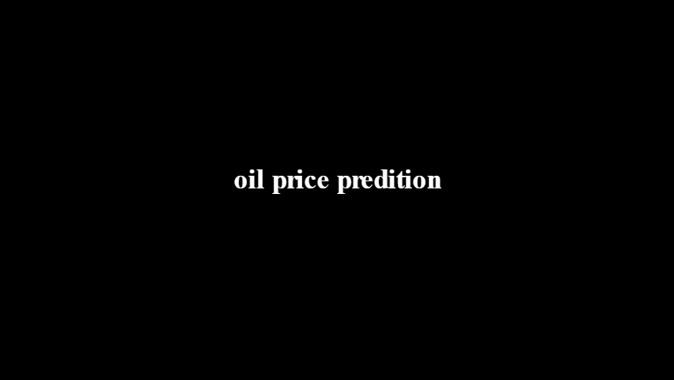

Slide 21


Thank you!

